Slide 1








































Emotional
Intelligence in
Children
Emotional intelligence and its importance in a child's life.

Slide 2


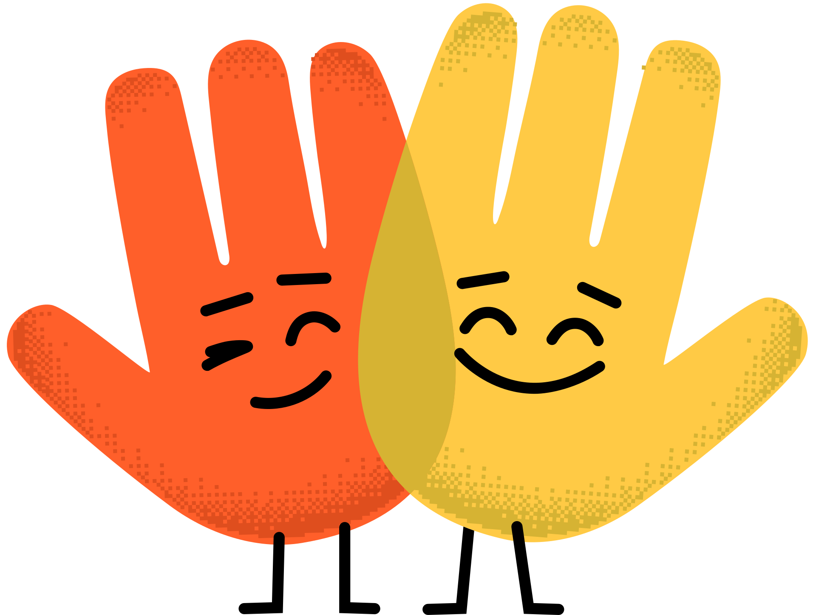








What is
intelligence?
emotional
The ability to recognize, understand, and manage your emotions.
Self-awareness
Self-regulation
Empathy
Social skills

Slide 3




developing
Why is
emotional intelligence important?
Improves relationships with friends and family.
Helps cope with difficult emotions.
Enhances academic and social success.

Slide 4

How to
recognize
emotions?
Help your child label their feelings.
Use emotion cards or facial expressions to show a variety of feelings.
When children understand their feelings, they can better express themselves and manage situations more effectively.

Slide 5
Developing
Self-Awareness
Teach children to recognize their emotional reactions.
Ask questions like, "What are you feeling?" and "Why do you think that?"
Help your child notice physical changes when experiencing emotions.

Slide 6
Managing
Emotions
Develop self-control techniques, such as breathing exercises.
Help your child think before reacting to difficult situations.

Slide 7
Developing
Empathy
Role-play to understand how others feel.
Discuss how others might feel in different situations.
Discuss with your child how their actions might affect others' feelings to develop empathy.

Slide 8
Developing
Social Skills
Practice playing together, listening, and communicating politely.
Teach children to support others and resolve conflicts.

Slide 9
Supporting Emotional Intelligence
Development
TIPS FOR PARENTS:
Be an example in expressing and managing emotions.
Encourage open discussions of feelings and experiences.

Slide 10
Emotional intelligence is the to success!
key
Emotional intelligence helps children become more confident and happy.
Continuous support and development will help the child adapt to life.

